Slide 1
Introduction to XML
Introduction
The Syntax of XML
XML Document Structure
Document Type Definitions
Namespaces
XML Schemas
Displaying Raw XML Documents
Displaying XML Documents with CSS
XSLT Style Sheets
Web Services

Slide 2
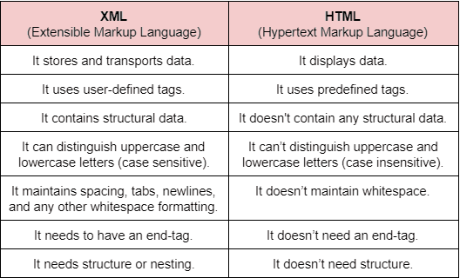
Difference between Html and Xml

Slide 3
Difference between Html and Xml
Focus on how data is described or storing and transport of data.
Xml is not a Presentation language.
It is a Standard Language, that provide framework to define more markup language.
Data can be stored of Non-Web application.
Extensible – its follow Tree Structure.
Extension is like .xml.
Always starts with Declaration. Like,
<?xml version = “1.0”>
Does syntax check.
Attribute values should be quoted.

Slide 4
Introduction to XML
The eXtensible Markup Language (XML)
Focus on how to describe the data.
Store and transfer data in Internet.
Clearly, it has processing of data.
XML has development of a collection of XML-based markup languages that are specified by recommendations developed by the World Wide Web Consortium (W3C).

Slide 5
A meta-markup language is a language for defining markup languages.
The Standard Generalized Markup Language (SGML) is a meta-markup language for defining markup languages that can describe a wide variety of document types.
In 1986, SGML was approved as an International Standards Organization (ISO) standard.
In 1990, SGML was used as the basis for the development of HTML as the standard markup language for Web documents.
In 1996, the W3C began work on XML, another meta-markup language.
The first XML standard, 1.0, was published in February 1998.

Slide 6
The second, 1.1, was published in 2004.
XML is not a markup language, it is a meta-markup language that specifies rules for creating markup languages.
When designing a markup language using XML, the designer must define a collection of elements that are useful in the intended area.
A markup language designed with XML is called an XML application.
However, a program that processes information stored in a document formatted with an XML application is also called an application.

Slide 7
To avoid confusion, we refer to an XML-based markup language as a tag set.
We call documents that use an XML-based markup language XML documents.
XML documents can be written by hand with a simple text editor.
This approach is, of course, impractical for large data collections, documents which are likely to be written by programs.
There are many XML-oriented text editors that assist with the creation and maintenance of XML documents.
Among these are the Altova XMLSpy, the graphical editor for Windows, the PSGML plug-in for the Emacs editor, XMLFox, and the Morphon XML-Editor.

Slide 8
The Syntax of XML
The syntax of XML can be thought of at two distinct levels.
First, there is the general low-level syntax of XML, which imposes its rules on all XML documents.
The other syntactic level is specified by XML schemas.
XML schemas specify the set of elements and attributes that can appear in a particular document or collection of documents and also the orders and arrangements in which they can appear.
An XML schema can be used to define an XML tag set.

Slide 9
An XML document can include several different kinds of statements. The most common are the data elements of the document.
XML documents may also include markup declarations, which are instructions to the XML parser, and processing instructions, which are instructions for an application program that will process the data described in the document.
All XML documents begin with an XML declaration, which looks like a processing instruction but technically is not one.
The XML declaration identifies the document as XML and provides the version number of the XML standard used. It may also specify an encoding standard.

Slide 10
Comments in XML are the same as in HTML. They cannot contain two adjacent dashes, for obvious reasons.
XML names are used to name elements and attributes. An XML name must begin with a letter or an underscore and can include digits, hyphens, and periods.
XML names are case sensitive, so Body, body, and BODY are all distinct names. There is no length limitation for XML names.
Every XML document defines a single root element, whose opening tag must appear on the first line of XML code.
All other elements of an XML document must be nested inside the root element.

Slide 11
XML tags, like those of HTML, are surrounded by angle brackets.
Every XML element that can have content must have a closing tag. Elements that do not include content must use a tag with the following form:
<element_name />
XML tags can have attributes, which are specified with name-value assignments. All attribute values must be enclosed by either single or double quotation marks.
An XML document that strictly adheres to these syntax rules is considered well formed.

Slide 12
The following is a simple, but complete, example:
<?xml version = "1.0" encoding = "utf-8"?>
<ad>
<year> 1960 </year>
<make> Cessna </make>
<model> Centurian </model>
<color> Yellow with white trim </color>
<location>
<city> Gulfport </city>
<state> Mississippi </state>
</location>
</ad>

Slide 13
XML Document Structure
An XML document often uses two auxiliary files: one that defines its tag set and structural syntactic rules and one that contains a style sheet to describe how the content of the document is to be printed or displayed.
An XML document consists of one or more entities, which are logically related collections of information, ranging in size from a single character to a chapter of a book.
One of these entities, called the document entity, is always physically in the file that represents the document.
The document entity can be the entire document, but in many cases, it includes references to the names of entities that are stored.

Slide 14
There are several reasons to break a document into multiple entities. First, it is good to define a large document as a number of smaller parts to make it more manageable.
Also, if the same data appears in more than one place in the document, defining that data as an entity allows any number of references to a single copy of it.
This approach avoids the problem of inconsistency among the occurrences.
Finally, many documents include information that cannot be represented as text, such as images. Such information units are usually stored as binary data.
If a binary data unit is logically part of a document, it must be a separate entity because XML documents cannot include binary data. These entities are called binary entities.

Slide 15
When an XML processor encounters the name of a nonbinary entity in a document, it replaces the name with the value it references. Binary entities can be handled only by applications that deal with the document, such as browsers. XML processors deal with text only.
Entity names can be any length. They must begin with a letter, a dash, or a colon. After the first character, a name can have letters, digits, periods, dashes, underscores, or colons. A reference to an entity is its name together with a pre- pended ampersand and an appended semicolon.

Slide 16
<![CDATA[ content ]]>
For example, instead of,
The last word of the line is &gt;&gt;&gt; here &lt;&lt;&lt;.
the following could be used:
<![CDATA[The last word of the line is >>> here <<<]]>
The opening keyword of a character data section is not just CDATA; it is, in effect, [CDATA[.
An important consequence of this rule is that there cannot be any spaces between the [ and the C or between the A (the last character of CDATA) and the second [.
The only thing that cannot appear in the content of a CDATA section is the closing delimiter, ]]>.

Slide 17
Because the content of a character data section is not parsed by the XML parser, any entity references that are included are not expanded.
For example, the content of the line,
<![CDATA[The form of a tag is &lt; tag name&gt;]]>
is as follows:
The form of a tag is &lt; tag name &gt;
XML documents can include elements, markup declarations, and processing instructions.
Every XML document has the form of a single document tree, so there can be just one root element.

Slide 18
Namespaces
It is often convenient to construct XML documents that use tag sets that are defined for and used by other documents. When a tag set is available and appropriate for a particular XML document or class of documents, it is better to use it than to invent a new collection of element types.
The W3C has developed a standard for XML namespaces.
An XML namespace is a collection of element and attribute names used in XML documents.
The name of a namespace usually has the form of a URI.
User-defined namespace names do not need to use the URI form, although that is a good way to prevent conflicts with namespace Names.

Slide 19
The name of a namespace for the elements and attributes of the hierarchy rooted at a particular element is declared as the value of the attribute xmlns. A namespace declaration for an element is given as the value of the xmlns attribute, as in the following:
<element_name xmlns [ :prefix] = URI>
The square brackets here indicate that what is within them is optional. The prefix, if included, is the name that must be attached to the names in the declared namespace. If the prefix is not included, the namespace is the default for the document.
A prefix is used for two reasons. First, most URIs are too long to be typed on every occurrence of every name from the namespace.

Slide 20
Second, a URI includes characters that are invalid in XML. Note that the element for which a namespace is declared is usually the root of a document.
As an example of a prefixed namespace declaration, consider the following:
<birds xmlns:bd = "http://www.audubon.org/names/species">

Slide 21
XML Schemas
A Document Type Definition (DTD) is a set of structural rules, which specify a set of elements and attributes that can appear in a document, as well as how and where these elements and attributes may appear.
Because of their deficiencies, several alternatives to DTDs have been developed to overcome their weaknesses.
The XML schema standard, which was designed by the W3C, is one of these alternatives.

Slide 22
Schema Fundamentals
Schemas can be related to the idea of a class and an object in an object-oriented programming language.
A schema is similar to a class definition; an XML document that conforms to the structure defined in the schema is similar to an object of the schema’s class. Schemas have three primary purposes.
First, a schema specifies the elements and attributes of an XML language.
Second, a schema defines the structure of the instance XML documents of the language, including where and how often the elements may appear.

Slide 23
Third, a schema specifies the data type of every element in its instance XML documents. It has been said that XML schemas are namespace centric.
In XML schemas, as in XML, namespaces are represented by URIs.
Because they must be unique, it is customary to use URIs that start with the author’s Web site address for namespaces.
For example, for namespaces that appear in this section, we use the prefix "http://cs.uccs.edu/", to which we add whatever name connotes the specific application.

Slide 24
Defining a Schema
Schemas themselves are written with the use of a collection of elements, or a vocabulary, from a namespace that is, in effect, a schema of schemas.
The name of this namespace is http://www.w3.org/2001/XMLSchema.
Some of the elements in the namespace are element, schema, sequence, and string.
Every schema has schema as its root element.

Slide 25
The schema element specifies the namespace for the schema of schemas from which the names of the schema’s elements and attributes will be drawn.
It often also specifies a prefix that will be used for the names in the schema. This namespace specification is:
xmlns:xsd = "http://www.w3.org/2001/XMLSchema"
A schema defines a namespace.
Xmlns is a reserved word, it is used to declare a namespace. Xmlns is used for binding namespace.
The name of the namespace defined by a schema must be specified with the targetNamespace attribute of the schema element.

Slide 26
The name of every top-level (not nested) element that appears in a schema is placed in the target namespace, which is specified by assigning a namespace to the target namespace attribute:
targetNamespace = "http://cs.uccs.edu/planeSchema“
If the names of the elements and attributes that are not defined directly in the schema element (because they are nested inside top-level elements) are to be included in the target namespace, schema’s elementFormDefault must be set to qualified, as follows:
elementFormDefault = "qualified"

Slide 27
The default namespace, which is the source of the unprefixed names in the schema, is given with another xmlns specification, but this time without the prefix:
xmlns = "http://cs.uccs.edu/planeSchema“
An example of a complete opening tag for a schema is as follows:
<xsd:schema
<!-- The namespace for the schema itself (prefix is xsd) --> xmlns:xsd = http://www.w3.org/2001/XMLSchema
<!-- The namespace where elements defined here will be placed -->

Slide 28
targetNamespace = http://cs.uccs.edu/planeSchema
<!-- The default namespace for this document (no prefix) --> xmlns = http://cs.uccs.edu/planeSchema
<!-- We want to put non-top-level elements in the target namespace -->
elementFormDefault = "qualified“
In this example, the target namespace and the default namespace are the same.

Slide 29
The following schema tag illustrates this approach:
schema
xmlns = "http://www.w3.org/2001/XMLSchema" targetNamespace = "http://cs.uccs.edu/planeSchema" xmlns:plane = "http://cs.uccs.edu/planeSchema" elementFormDefault = "qualified">

Slide 30
Defining a Schema Instance
An instance of a schema must include specifications of the namespaces it uses. These specifications are given as attribute assignments in the opening tag for the root element of the schema.
First, an instance document normally defines its default namespace to be the one defined in its schema.
For example, if the root element is planes, we could have
<planes
xmlns = http://cs.uccs.edu/planeSchema
... >

Slide 31
The second attribute specification in the root element of an instance document is for the schemaLocation attribute.
This attribute is used to name the standard namespace for instances, which includes the name XMLSchema- instance.
This namespace corresponds to the XMLSchema namespace used for schemas.
The following attribute assignment specifies the XMLSchema-instance namespace and defines the prefix, xsi, for it:
xmlns:xsi = "http://www.w3.org/2001/XMLSchema-instance"

Slide 32
Third, the instance document must specify the file name of the schema in which the default namespace is defined.
This is accomplished with the schema-Location attribute, which takes two values: the namespace of the schema and the file name of the schema. This attribute is defined in the XMLSchema-instance namespace, so it must be named with the proper prefix, as in the assignment
xsi:schemaLocation = "http://cs.uccs.edu/planeSchema
planes.xsd"

Slide 33
An Overview of Data Types
There are two categories of user-defined schema data types: simple and complex.
A simple data type is a data type whose content is restricted to strings.
A simple type cannot have attributes or include nested elements. The string restriction seems like it would make simple types a very narrow type category, but in fact it does not, because a large collection of predefined data types is included in the category. Some of these predefined data types are mentioned in this section.
A complex data type can have attributes and include other data types as child elements.

Slide 34
The XML schema defines 44 data types, out of which 19 are primitive and 25 are derived.
The primitive data types include string, Boolean, float, time, and anyURI.
The predefined derived types include byte, long, decimal, unsignedInt, positiveInteger, and NMTOKEN.

Slide 35
Simple Types
Elements are defined in an XML schema, which is from the XMLSchema namespace. Recall that the prefix xsd is normally used for names from this namespace. An element that is named includes the name attribute for that purpose.
The other attribute that is necessary in a simple element declaration is type, which (of course) is used to specify the type of content allowed in the element. Here is an example:
<xsd:element name = "engine" type = "xsd:string" />

Slide 36
An instance of the schema in which the engine element is defined could have the following element:
<engine> inline six cylinder fuel injected </engine>
An element can be given a default value with the default attribute:
<xsd:element name = "engine" type = "xsd:string"
default = "fuel injected V-6" />
Elements can have constant values, meaning that the content of the defined element in every instance document has the same value.

Slide 37
Constant values are given with the fixed attribute, as in the following example:
<xsd:element name = "plane" type = "xsd:string"
fixed = "single wing" />
A simple user-defined data type is described in a simple-Type element with the use of facets.
Facets must be specified in the content of a restriction element, which assigns the base type name to the base attribute.
The facets themselves are given in elements named for the facets: the value attribute specifies the value of the facet.
Users can also define new complex types. Instances of schemas can be validated with several different validation programs that are now available.

Slide 38
Complex Types
Most XML documents include nested elements, so few XML schemas do not have complex types. Although there are several categories of complex element types, the discussion here is restricted to those called element-only elements, which can have elements in their content, but no text.
All complex types can have attributes. Complex types are defined with the complexType element.
The elements that are the content of an element-only element must be contained in an ordered group, an unordered group, a choice, or a named group.
Only ordered and unordered groups are discussed here.

Slide 39
The sequence element is used to contain an ordered group of elements, as in the following type definition:
<xsd:complexType name = "sports_car">
<xsd:sequence>
<xsd:element name = "make" type = "xsd:string" />
<xsd:element name = "model" type = "xsd:string" />
<xsd:element name = "engine" type = "xsd:string" />
<xsd:element name = "year" type = "xsd:decimal" />
</xsd:sequence>
</xsd:complexType>

Slide 40
Validating Instances of Schemas
An XML schema provides a definition of a category of XML documents.
Fortunately, several XML schema validation tools are available.
One of them is named xsv, an abbreviation for XML Schema Validator. It was developed by Henry S. Thompson and Richard Tobin at the University of Edinburgh in Scotland.
If the schema and the instance document are available on the Web, xsv can be used online, like the XHTML validation tool at the W3C Web site. This tool can also be downloaded and run on any computer. The Web site for xsv is http://www.w3.org/XML/Schema#XSV.

Slide 41
The output of xsv is an XML document. When the tool is run from the command line, the output document appears on the screen with no formatting, so it is a bit difficult to read.
The following is the output of xsv run on planes.xml:
<?XML version='1.0' encoding = 'utf-8'?>
<xsv docElt='{http://cs.uccs.edu/planeSchema}planes' instanceAssessed='true'
instanceErrors = '0' rootType='[Anonymous]' schemaErrors='0'
schemaLocs='http://cs.uccs.edu/planeSchema -> planes.xsd'
target='file:/c:/wbook2/xml/planes.xml' validation='strict'

Slide 42
version='XSV 1.197/1.101 of 2001/07/07 12:10:19'
xmlns='http://www.w3.org/2000/05/xsv' >
<importAttempt URI='file:/c:wbook2/xml/planes.xsd' namespace='http://cs.uccs.edu/planeSchema' outcome='success' />
</xsv>
Each line is filled to the right end of the screen, and attribute values are broken across line boundaries in several places.
One useful thing to know about validation with xsv is that if the schema is not in the correct format, the validator will report.

Slide 43
Displaying Raw XML Documents
An XML parser includes a default style sheet, which is used when no other style sheet is specified in the document being parsed.
The default style sheets imply produces a some what stylized listing of the XML.
CSS style sheets can be used with XML documents to provide formatting information. Such a CSS style sheet has the form of an external CSS style sheet for HTML.
The Firefox 3 (FX3) browser display of the planes.xml document is shown in Figure:

Slide 44
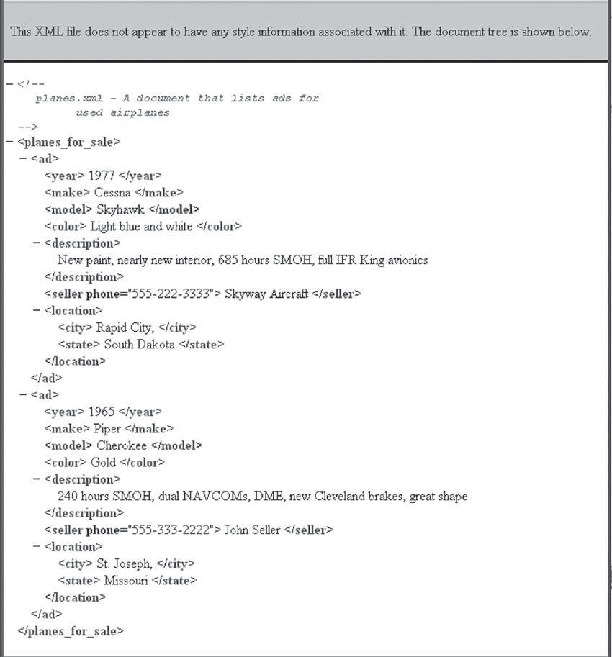

Slide 45
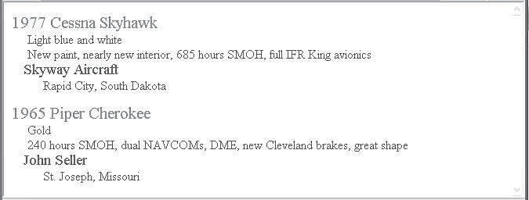
shows the display of planes.xml, in which the planes.css style sheet is used to format the document.
The result of using a CSS style sheet to format planes.xml

Slide 46
Displaying XML Documents with CSS
Style-sheet information can be provided to the browser for an XML document in two ways.
First, a Cascading Style Sheet (CSS) file that has style information for the elements in the XML document can be developed.
Second, the XSLT style-sheet technology, which was developed by the W3C, can be used.
Although using CSS is effective, XSLT provides far more power over the appearance of the document’s display.

Slide 47
<!-- planes.css - a style sheet for the planes.xml document -->
ad { display: block; margin-top: 15px; color: blue;}
year, make, model { color: red; font-size: 16pt;}
color {display: block; margin-left: 20px; font-size: 12pt;}
description {display: block; margin-left: 20px; font-size: 12pt;}
seller { display: block; margin-left: 15px; font-size: 14pt;}
location {display: block; margin-left: 40px; }
city {font-size: 12pt;} state {font-size: 12pt;}

Slide 48
The connection of an XML document to a CSS style sheet is established with the processing instruction xml-stylesheet, which specifies the particular type of the style sheet via its type attribute and the name of the file that stores the style sheet via its href attribute.
For the planes example, this processing instruction is as follows:
<?xml-stylesheet type = "text/css" href = "planes.css" ?>

Slide 49
XSLT Style Sheets
The eXtensible Stylesheet Language (XSL) is a family of recommendations for defining the presentation and transformations of XML documents.
It consists of three related standards:
XSL Transformations (XSLT),
XML Path Language (XPath), and
XSL Formatting Objects (XSL-FO).
Each of these has an importance and use of its own.
Together, they provide a powerful means of formatting XML documents. Because the primary use of XSL-FO is to generate high-quality printable documents in formats such as PDF and PostScript.

Slide 50
XSLT style sheets are used to transform XML documents into different forms or formats, including XSL-FO, HTML, and plain text.
When the output is HTML, it is used primarily for display. In the transformation of an XML document, the content of elements can be moved, modified, sorted, and converted to attribute values, among other things.
XSLT style sheets are XML documents, so they can be validated against XML schemas. They can even be transformed with the use of other XSLT style sheets.

Slide 51
Overview of XSLT
XSLT is actually a simple declarative programming language, somewhat related to the logic programming language Prolog.
Included in XSLT are functions with parameters, names to which values can be bound, selection constructs, and conditional expressions for multiple selection.
The syntactic structure of XSLT is XML, so each statement is specified with an element.
This approach makes XSLT documents appear very different from programs in a typical imperative programming language, but not completely different from programs written in Prolog.

Slide 52
XSLT processors take both an XML document and an XSLT document as input. The XSLT document is the program to be executed; the XML document is the input data to the program.
Parts of the XML document are selected, possibly modified, and merged with parts of the XSLT document to form a new document, which is sometimes called an XSL document.
Because the XSL document is also an XML document, it could be again the input to an XSLT processor.
The output document can be stored for future use by applications, or it may be immediately displayed by an application, often a browser.
Neither the XSLT document nor the input XML document is changed by the XSLT processor.

Slide 53
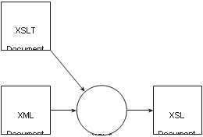
The transformation process used by an XSLT processor
XSLT
Processor

Slide 54
XSL Transformations for Presentation
Although XSLT style sheets can be used to control page layout, including orientation, writing direction, margins, and page numbering.
XSLT includes more than 50 formatting object (element) types and more than 230 attributes, so it is a large and complex tag set.
XSLT processor processes an XML document with its associated XSLT style-sheet document and produces as its output an XSL document that is an HTML document to be displayed.

Slide 55
An XML document that is to be used as data to an XSLT style sheet must include a processing instruction to inform the XSLT processor that the style sheet is to be used. The form of this instruction is as follows:
<?xml-stylesheet type = "text/xsl" href =
"XSL_stylesheet_name" ?>
There is an issue with the MIME type in this instruction: text/xsl is not a standard type.

Slide 56
The following is a simple example of an XML document that
illustrates XSLT formatting:
<?xml version = "1.0" encoding = "utf-8"?>
<!-- xslplane.xml -->
<?xml-stylesheet type = "text/xsl" href = "xslplane1.xsl" ?>
<plane>
<year> 1977 </year>
<make> Cessna </make>
<model> Skyhawk </model>
<color> Light blue and white </color>
</plane>

Slide 57
Web Services
The movement toward Web services began in earnest when Bill Gates, who was Microsoft chairman at the time, introduced a concept he called BizTalk in 1999.
BizTalk later was renamed .NET. The idea was to provide the technologies to allow software in different places, written in different languages and resident on different platforms, to connect and interoperate.
The Web began as a Web service focused on information and is still primarily just that. Through two fundamental HTTP methods, GET and POST, and a vast collection of public markup documents, information is provided to anyone with an Internet connection and a computer running a browser.

Slide 58
The more general concept of a Web service is a similar technology for services. Rather than deploying documents through a Web server, services are deployed (through the same Web server). Rather than documents, access to software components is provided.
Components are not downloaded, but are run on the Web server as a remote service. In most cases, the components are remotely callable methods. Web services are, of course, not a completely new idea: Remote Procedure Call (RPC) is an earlier and closely related concept.
RPC was invented to allow distributed components to communicate.

Slide 59
There were two successful (widely used) RPC technologies: DCOM and CORBA. Both, however, are too complex to provide a simple and convenient way to support interoperability among Web services.
Three roles are required to provide and use Web services: service providers, service requestors, often called consumers, and a service registry.
A service provider must develop and deploy software that provides a service.

Slide 60
The W3C language designed for writing such descriptions is Web Services Definition Language which is an XML tag set.
The WSDL description is published on a Web server, just as is a Web-accessible document. It is used to describe the specific operations provided by the Web service, as well as the protocols for the messages the Web service can send and receive.
The descriptions of data, both input and output, in a WSDL description are often written in XML schema.
A Web services registry is created with another standard protocol: Universal Description, Discovery, and Integration Service (UDDI).
UDDI also provides ways to query a Web services registry to determine what specific services are available.

